Slide 1


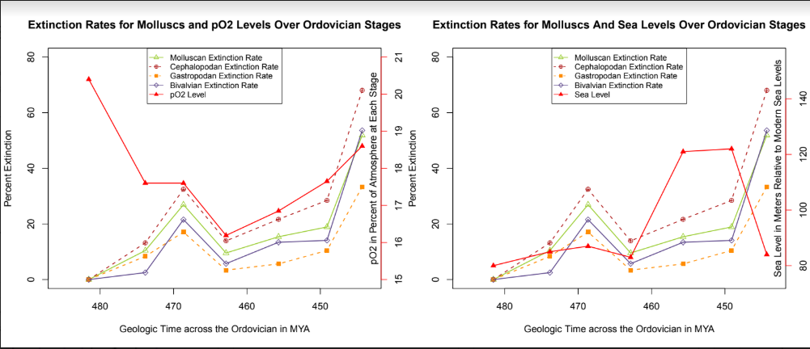
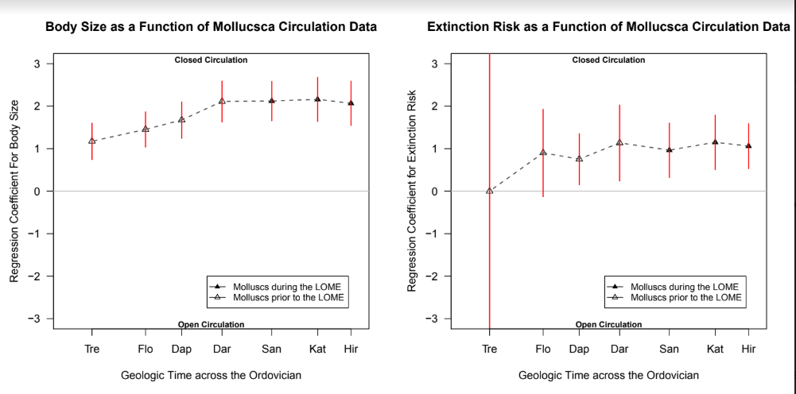
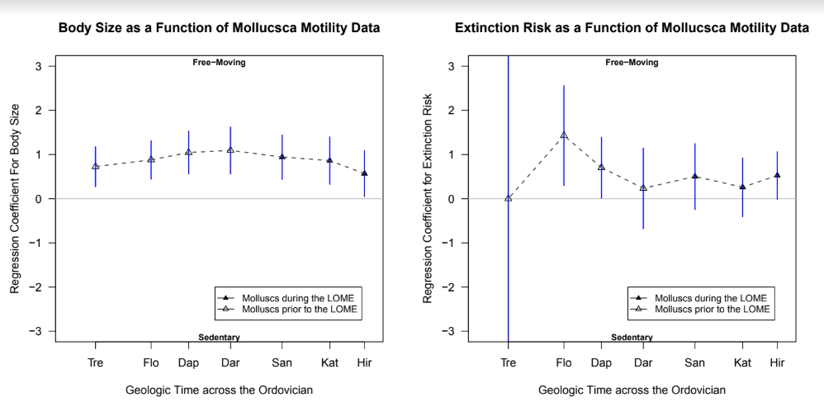
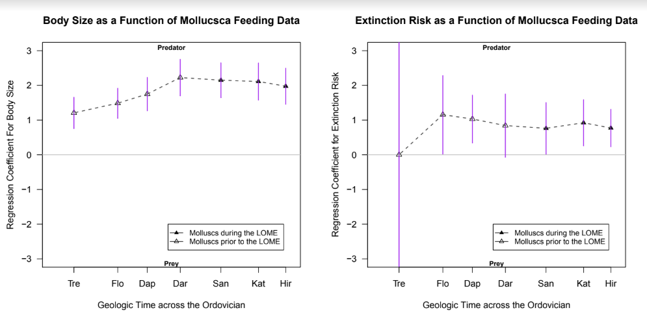
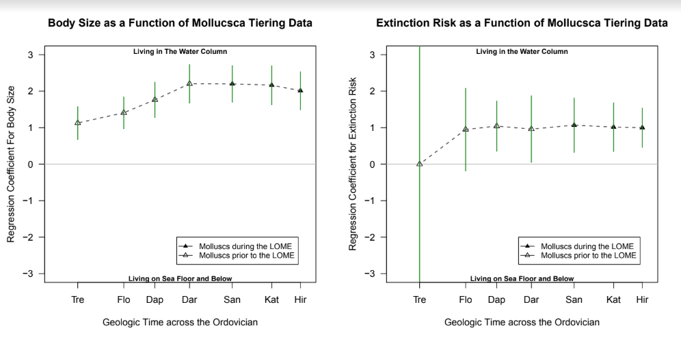
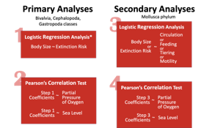
Driving Factors of Extinction for Molluscs During the Late Ordovician Mass Extinction
Abstract
Figures
While trends between extinction and body size have been explored extensively, hence the coining of the Lilliput Effect, or the noticed tendency for smaller organisms to remain after a mass extinction, few have studied this hypothesized trend within the Late Ordovician Mass Extinction. None have attempted to observe it with Mollusca as a focal point. Additionally, our research investigated ecological factors and their relationship with body size and extinction risk. First, we divided data from Heim et. al. 2015 into three main classes, Cephalopoda, Bivalvia, and Gastropoda. We ran logistic regression analyses to determine the odds of a higher extinction rate based on calculated fossil biovolume. Next, we ran Pearson’s correlation test to compare the odds to the sea level and pO2 of each Ordovician stage. Logistic regression analyses were performed on the entire molluscan dataset, comparing body size and extinction rates to circulation, feeding, motility, and tiering data, followed by correlation tests between these odds and sea level and pO2.
While our first test for the main classes yielded no significant results, our second tests involving ecological traits found significant (p < 0.05) and strongly positive coefficients. For example, there are high odds of extinction for molluscs with closed circulation. The coefficients for the regression between extinction risk and genera with closed circulation were 1.06 and 1.15 in the Hirnantian and Katian, indicating that such organisms were more likely to go extinct. Analysis revealed this likelihood had actually reduced during the LOME. Additionally, there is a strong correlation between the coefficients for extinction and body size for the traits of predatory feeding, water column tiering, and a closed circulation, all features of cephalopods, indicating that the high odds are a result of cephalopodic extinction. In the end, while there exists no clear relationship between body size and extinction for molluscs in the LOME, alternative physiological and ecological information provide better predictions for body size and extinction risk for molluscs in the LOME.
These factors clearly play a role in the underpinning mechanisms of mass extinctions, largely rejecting the Lilliput Effect and indicating that extinction trends are more complex than simple correlations.
.
Methodology

